Slide 1
Marko Vasic , Aditya Kanade , Petros Maniatis , David Bieber ,
Rishabh Singh
2020-05-20
JuHyoung Kim
kjhkjh75@naver.com

Slide 2
Explore two tasks to illustrate the advantages of exposing more semantic structure of programs
1) Consider the VARNAMING task,
2) Introduce the variable misuse prediction task(VARMISUSE)

Slide 3
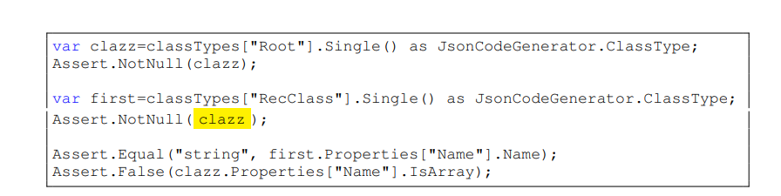
“yellow” should be placed with “clazz” position.

Slide 4
Contribution
1) Define the VARMISUSE task as a challenge for machine learning modeling
of source code, requires to learn semantics of programs
2) Present deep learning models for solving the VARNAMING and
VARMISUSE by modeling graph structure
3) evaluate models on a large dataset of real-world source code
4) Document practical relevance of VARMISUSE by summarizing some
bugs that we found in mature open-source software projects

Slide 5
- Source code file as a sequence of tokens t0 . . . tN = T
- Some tokens tλ0 , tλ1 . . . are variables
We call a token tokλ where we want to predict the correct variable usage a slot
For training and evaluation purposes, a correct solution is one that simply matches the ground truth

Slide 6
MODEL : PROGRAMS AS GRAPHS
Gated Graph Neural Networks
graph set of Nodes, node features , edge sets
E = (E1, . . . , EK) K is the number of edge types

Slide 7
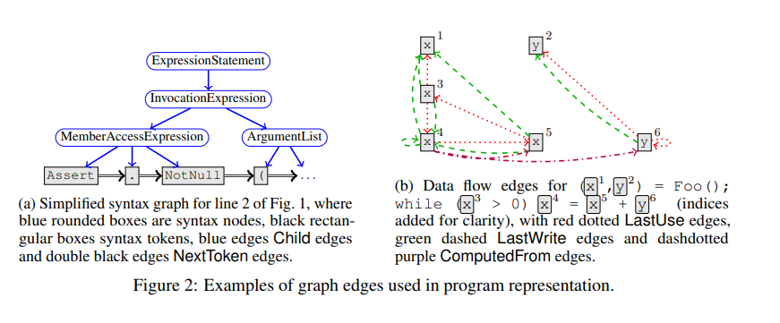

Slide 8
NEURAL PROGRAM REPAIR BY JOINTLY LEARNING TO LOCALIZE AND REPAIR
ICLR 2019

Slide 9
Evaluation
Incorrect slot placement (occurs frequently in the enumerative approach)
AddBugAny : injected VARMISUSE bug is at a random location
AddBugNear : Injected VARMIUSED bug within two variable-use locations from the slot
NoBugAny and NoBugNear

Slide 10
Learning How to Mutate Source Code from Bug-Fixes
M. Tufano, C. Watson, G. Bavota, M. Di Penta, M. White, D. Poshyvanyk
ICSME 2019

Slide 11
Learning How to Mutate Source Code from Bug-Fixes
M. Tufano, C. Watson, G. Bavota, M. Di Penta, M. White, D. Poshyvanyk
ICSME 2019

Slide 12
- INTRODUCTION
Mutation testing aims at injecting artificial faults into the program`s source code
Mutants can guide the design or even the automatic generation of a test suite
Conjecture that mutants can be automatically learned from previous fixes.
Propose an approach for automatically learning mutants from actual bug fixes.
Mined bug-fixing commits from repositories -> Extract change operations using
an AST-based differencing tool ->abstract them -> cluster similar changes
-> Learn from the changes using RNN encoder-decoder architecture.
Can determine where and how to mutate source code and to introduce new
literals and identifiers in the mutated code

Slide 13
A buggy code fragment arguably represent the perfect mutant for the fixed code
1) Mutation of the fixed code
2) Mutation exposed a buggy behavior
3) Buggy code doesn`t represent a trivial mutant
4) Test suite didn`t detect the bug in the buggy version.
Evaluate on 787k bug-fixing commits
1) How similar the learned mutants are as compared to real bugs
2) How specialized models can be used to generate specific set of mutants
3) From a qualitative point of view, what operators were the models able to
learn

Slide 14
- Contributions
Novel approach for learning how to mutate code from bug-fixes.
Empirical evidence that our models are able to learn diverse mutation operators related that are closely to real bugs.
Data and source code to enable replication

Slide 15
Approach
Start by mining bug-fixing commits from thousands of GitHub repositories
Extract method-level pairs of buggy and corresponding fixed code
(call transformation pairs(TPs))
Extract a list of edit actions(A) performed between the buggy and fixed code
Use a Java Lexer and Parser to abstract the source code of the TPs
The output of this phase is the set of abstracted TPs and their corresponding
mapping M which allows reconstructing the original source code
Generate different dataset of TPs
Each set of TPs we use an encoder-decoder model to learn how to transform a
fixed piece of code into the corresponding buggy version.

